Slide 1
WELCOME
JSP SERVLET PROJECT
‘TO LET – ADDVERTISING AGENCY’
1
DEVELOPED BY SHARIFUL ISLAM
GO TO
1
2
3
4
5
6
7
8
9
+
+
+

Slide 2

SUBMITTED TO
MD. MOSHAHIDUL ISLAM
PROJECT CONSULTANT, J2EE
IDB-BISEW
GO TO
1
2
3
4
5
6
7
8
9
+
+
+

Slide 3
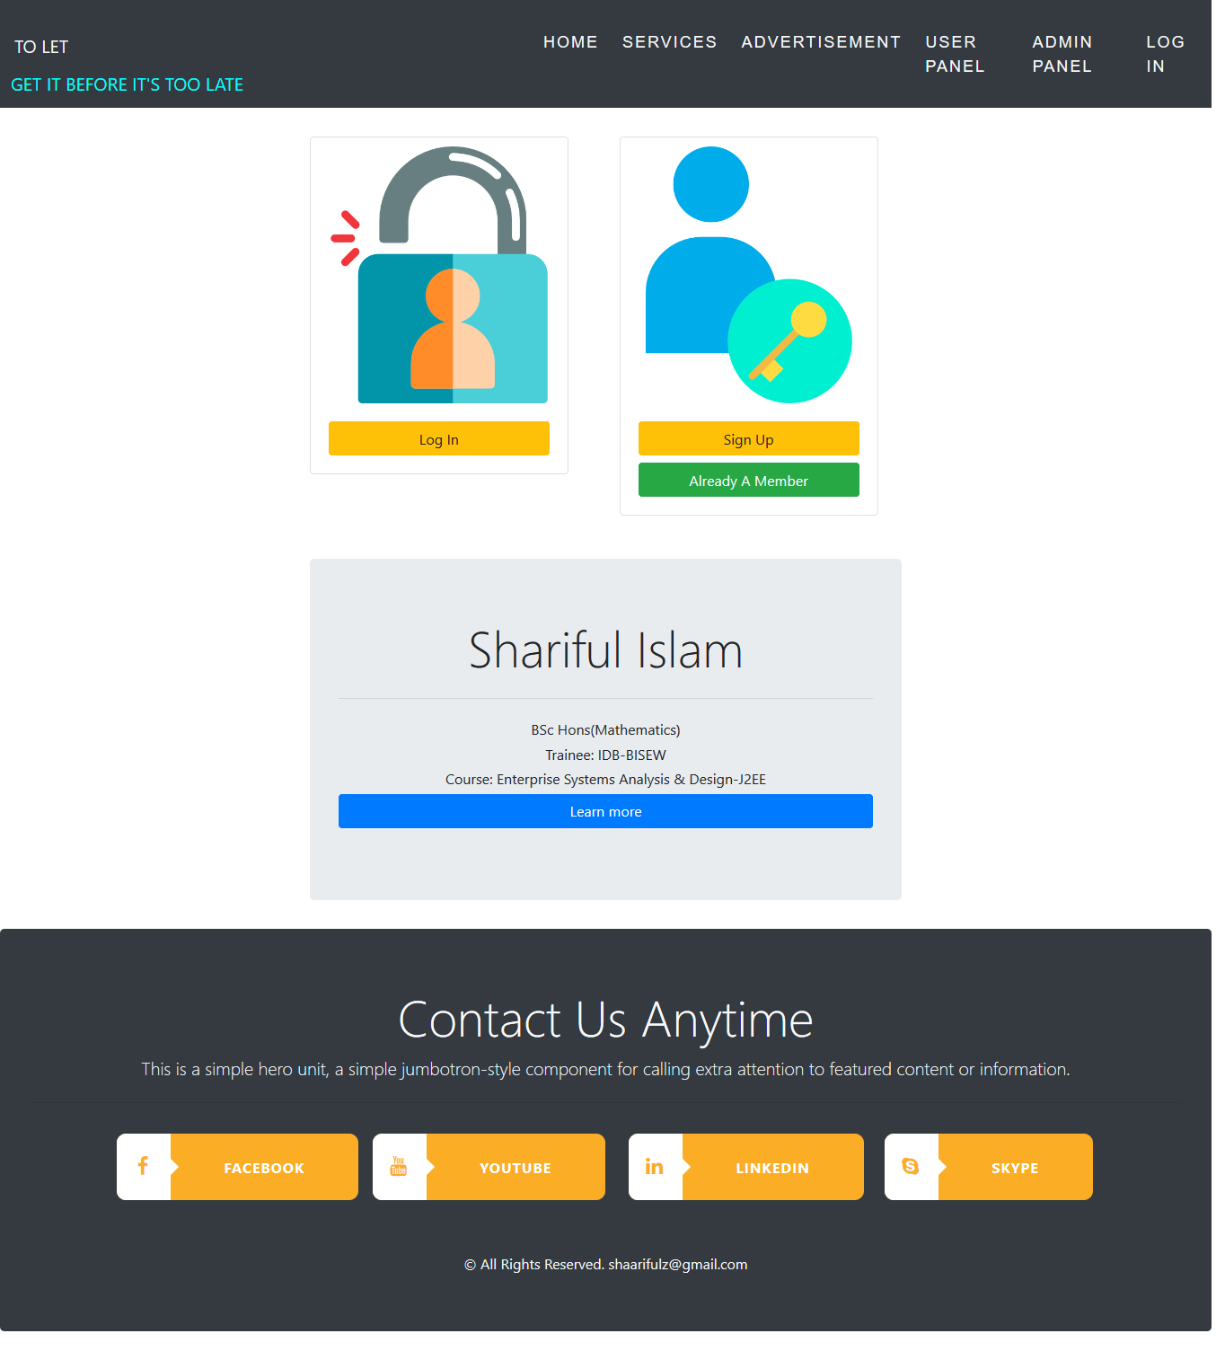
MEMBER NEED TO LOG IN
GO TO
1
2
3
4
5
6
7
8
9
+
+
+

Slide 4
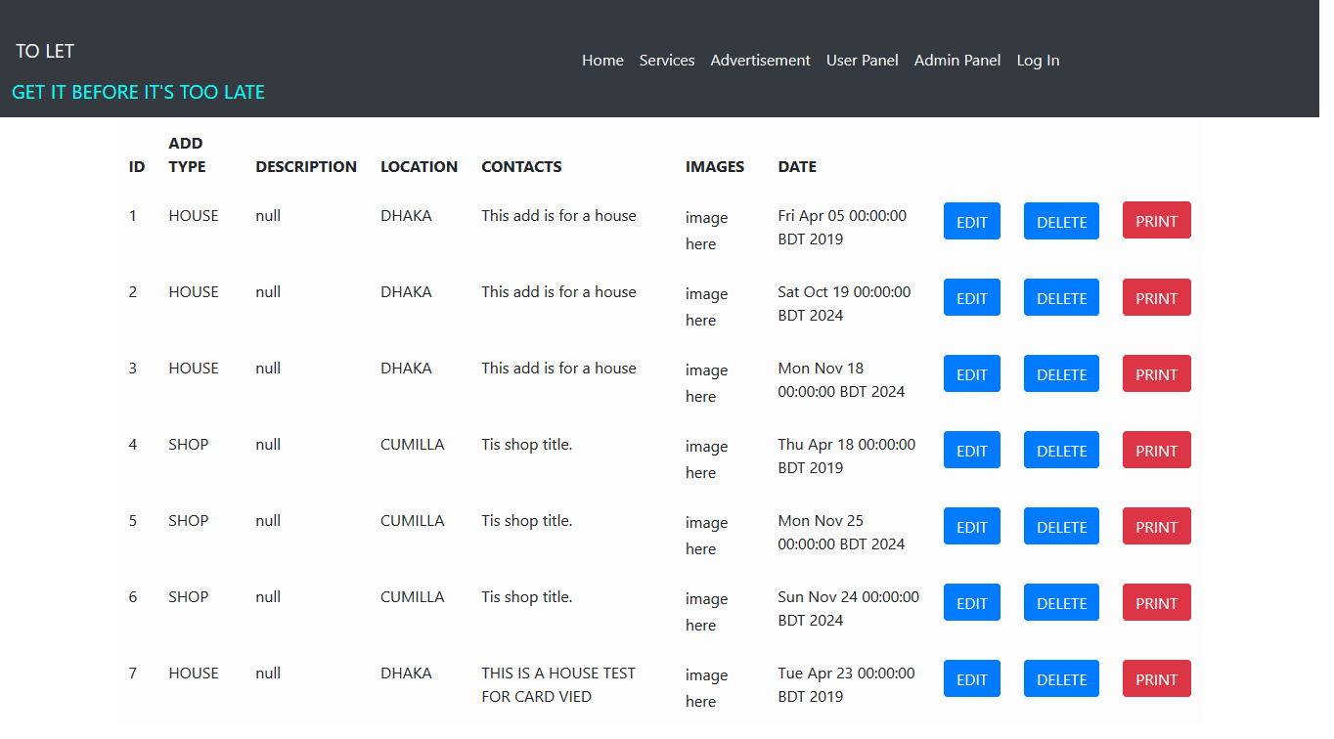
ADMIN PANEL
GO TO
1
2
3
4
5
6
7
8
9
+
+
+

Slide 5
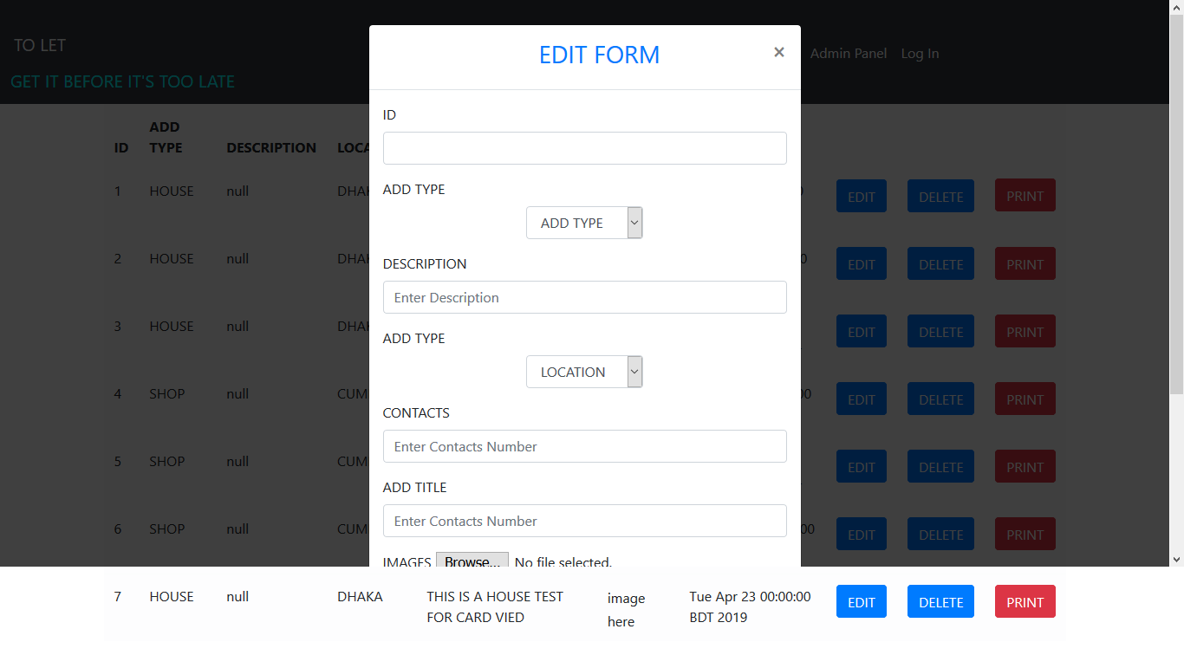
EDIT FORM FOR ADMIN
GO TO
1
2
3
4
5
6
7
8
9
+
+
+

Slide 6
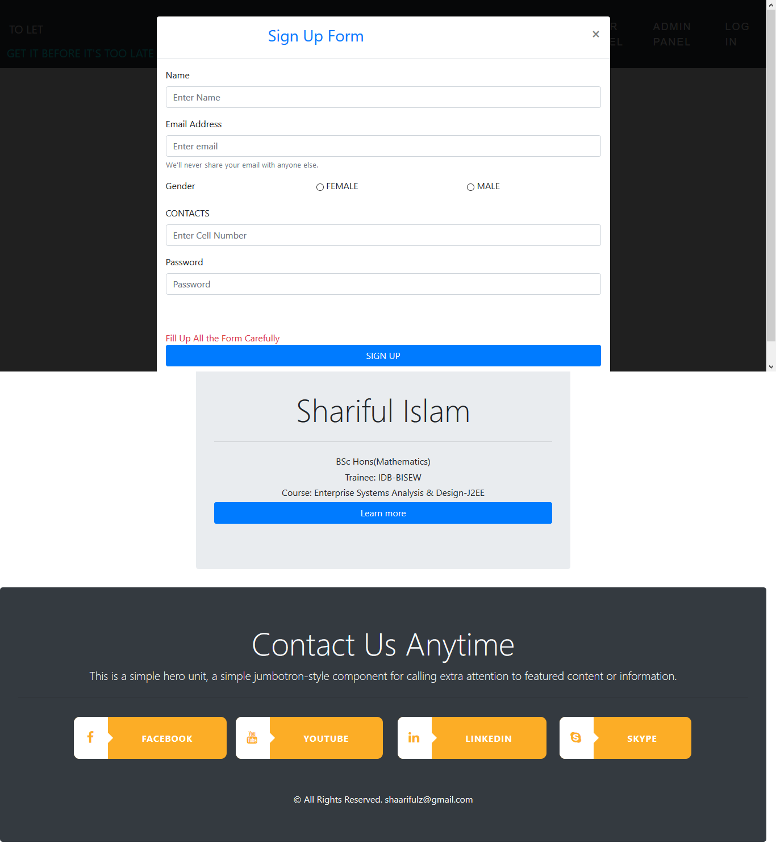
USER SIGN UP
GO TO
1
2
3
4
5
6
7
8
9
+
+
+

Slide 7
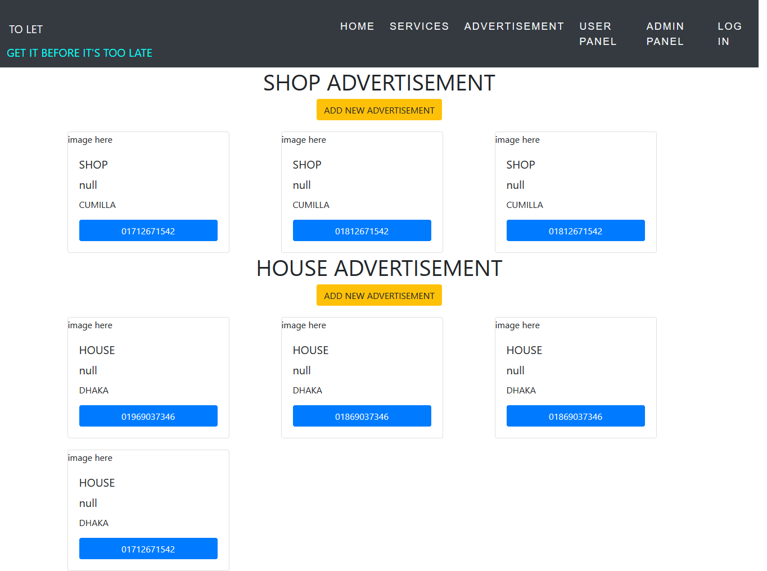
USER PANEL
GO TO
1
2
3
4
5
6
7
8
9
+
+
+

Slide 8
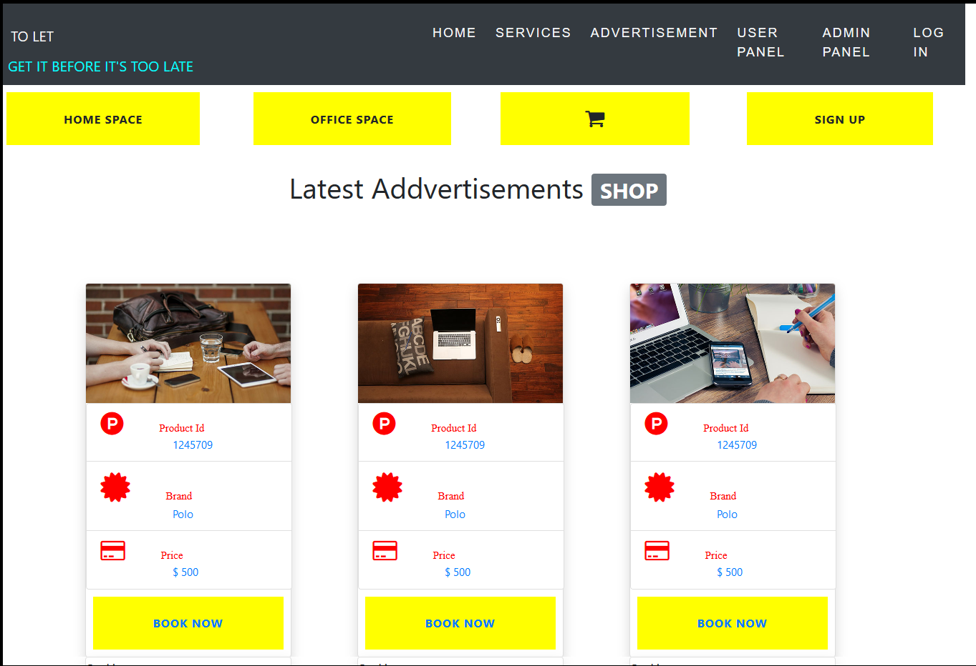
INDEX PAGE
GO TO
1
2
3
4
5
6
7
8
9
+
+
+

Slide 9



OUR SPECIALITY
BEST SELLER
HOME DELIVERY
SUPPORT
AWERD
AWERD
AWERD
BEST SELLER AWERD 2017
CUSTOMER SATISFACTION 100%
24/7 SUPPORT TEAM SERVICES
GO TO
1
2
3
4
5
6
7
8
9
+
+
+

Slide 10
THANK YOU
VISIT US ANYTIME
GO TO
1
2
3
4
5
6
7
8
9
+
+
+

